Slide 1

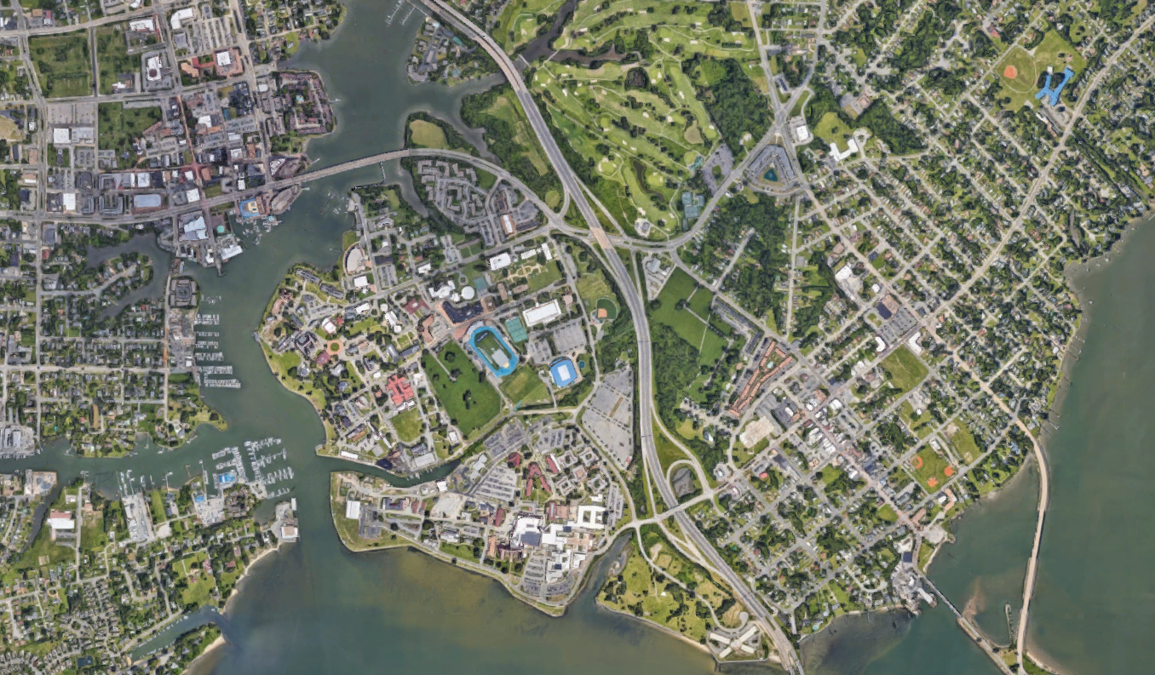

Please keep to the same format as provided, same font and sizing, same legend and directional.
This item MUST be returned in a fully editable version, including the map background used and all line markings.
Do not embed the map, street labels, or pipeline markings.
Whenever possible use a Google map (Earth View) image (north up)
Map Content must include source attribution within the maps area.
You can find the attribution in the line(s) shown on the bottom of the Content in the products along with copyright notices, such as “Map data ©2020 Google”. Note that the exact text of the attribution changes based on geography and content type. The attribution text must be legible to the average viewer or reader.
Turn off street labels in Google and create your own (using the template/format provided) for the most prevalent streets and building.
All colors should be those that standout against the background
Project Map
Public Project Name
LEGEND
Pipe to be Abandoned and Filled
Proposed Sewer Pipe
Completed Sewer Pipe
Current Work Area
Nansemond
River
Woodlands Golf Course
Mill Point Park
Settlers Landing Road
Eaton Street
West County Street
Hampton University
Emancipation Drive
William R Harvey Way
Hampton National Cemetery Phoebus
Bainbridge Avenue
Armstrong Stadium
Shore Road
Cameron Street
Downes Street
S Willard Avenue
Interstate 64
HRSD’s vision is that our communities will have clean waterways and reliable water resources for generations to come.

